Slide 1
E4S: Extreme-Scale Scientific Software Stack https://e4s.io
Sameer Shende Performance Research Laboratory, OACISS, U. Oregon
sameer@cs.uoregon.edu
Sunday, June 16, 2019, 2pm – 6pm, Monte Rosa 1,2
ISC-HPC 2019 conference
Frankfurt, Germany

Slide 2
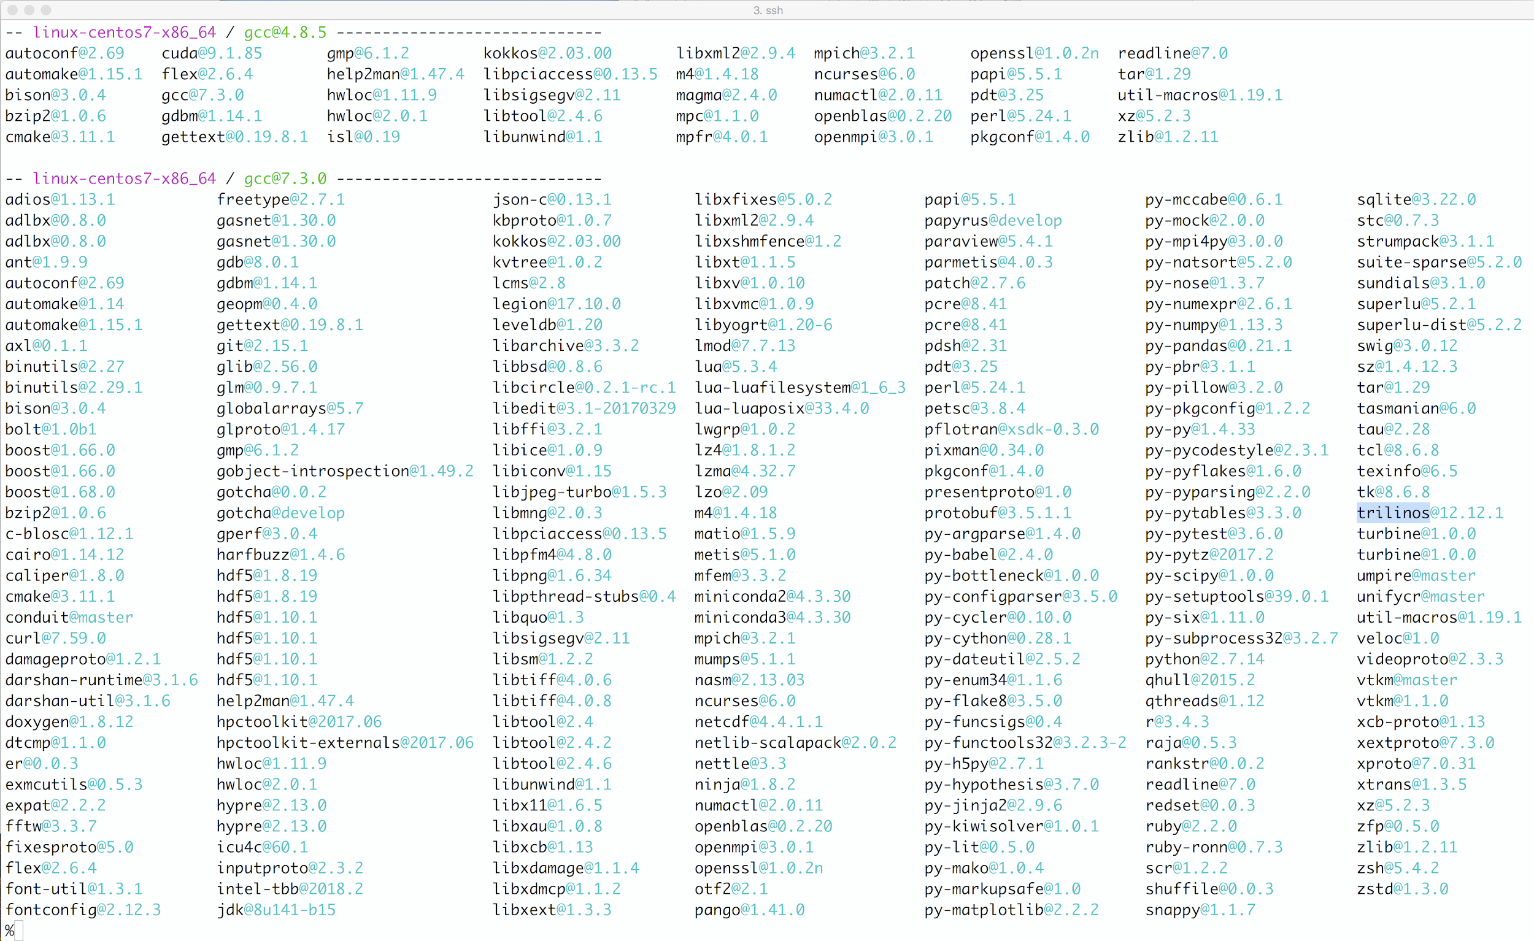
Extreme-Scale Scientific Software Stack (E4S) https://e4s.io
Spack [http://spack.io] is the primary means for software delivery
SDKs
Containers for HPC that include ECP ST products.
Container runtimes supported
Docker
Dockerhub: exascaleproject/sdk:AHM19
Charliecloud
Shifter
Singularity
VirtualBox Open Virtualization Appliance (OVA) image that contains these runtimes
MPI replacement strategies to use native network interconnect

Slide 3
Docker
% docker pull exascaleproject/sdk:AHM19
Using USB stick or images from http://e4s.io:
% cd /Volumes/ECP_SDK/Docker;
% gunzip –c ecp.tgz | docker load % docker images
Mount home directory:
% docker –i –v $HOME:$HOME –t exascaleproject/sdk:AHM19 /bin/bash
% which spack
% cp –r /usr/local/packages/ecp/demo . ; cd demo; cat README

Slide 4
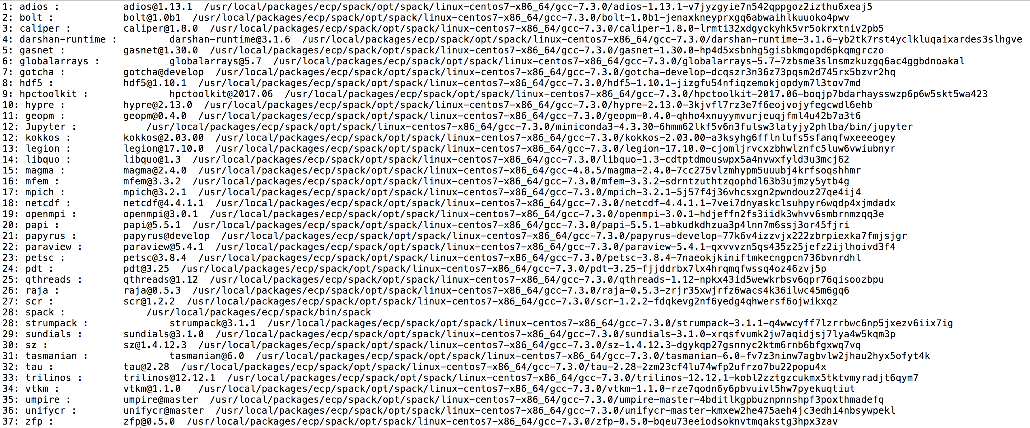
E4S Second Release (37+ ST products) exascaleproject/sdk:AHM19 (on Dockerhub)

Slide 5
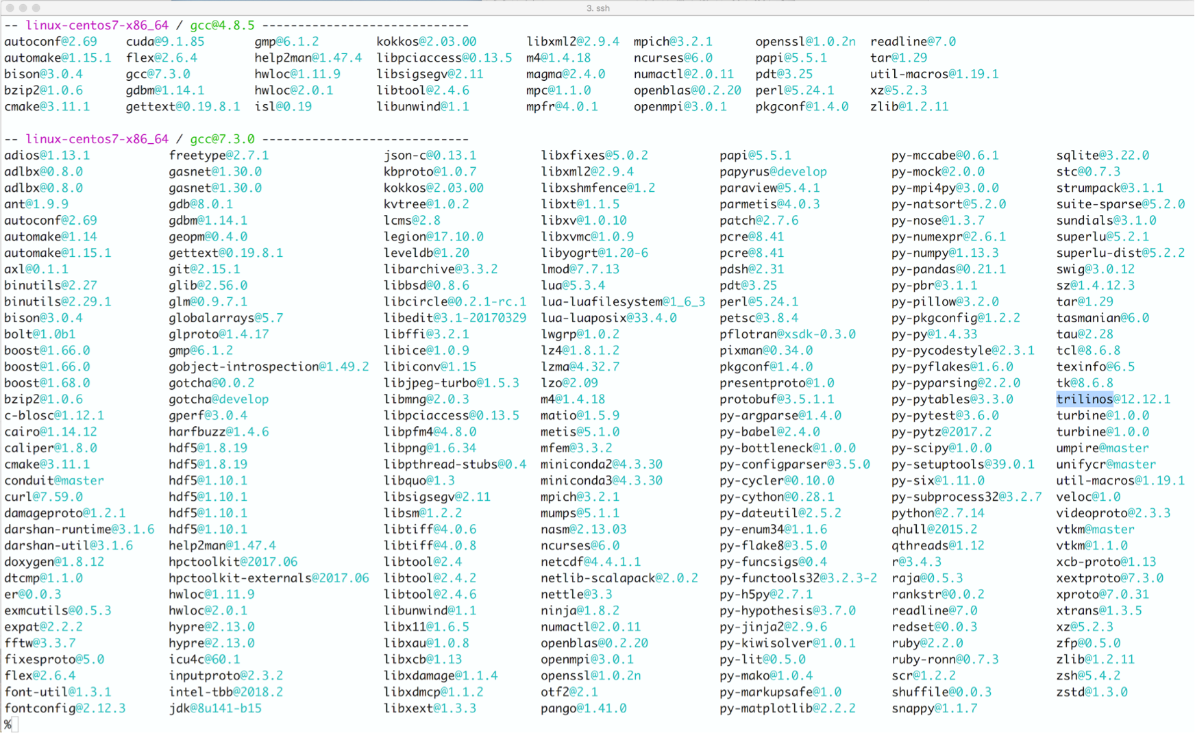
Extreme-Scale Scientific Software Stack (E4S) http://e4s.io
Containers for HPC that include ECP ST products.

Slide 6
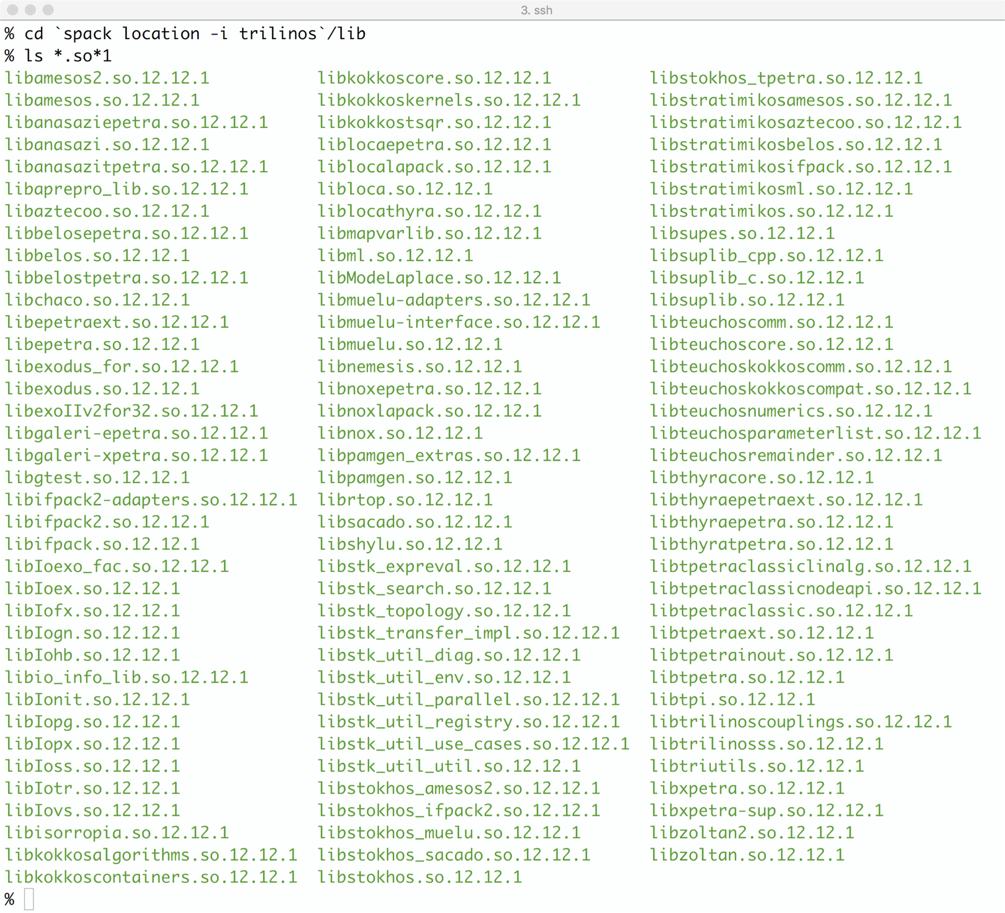
Extreme-Scale Scientific Software Stack (E4S) http://e4s.io

Slide 7
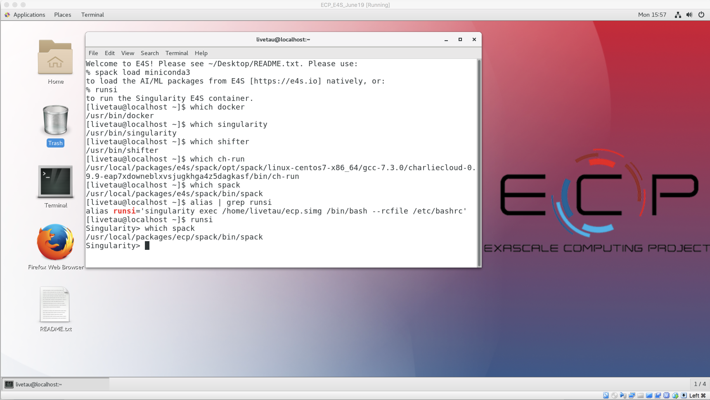
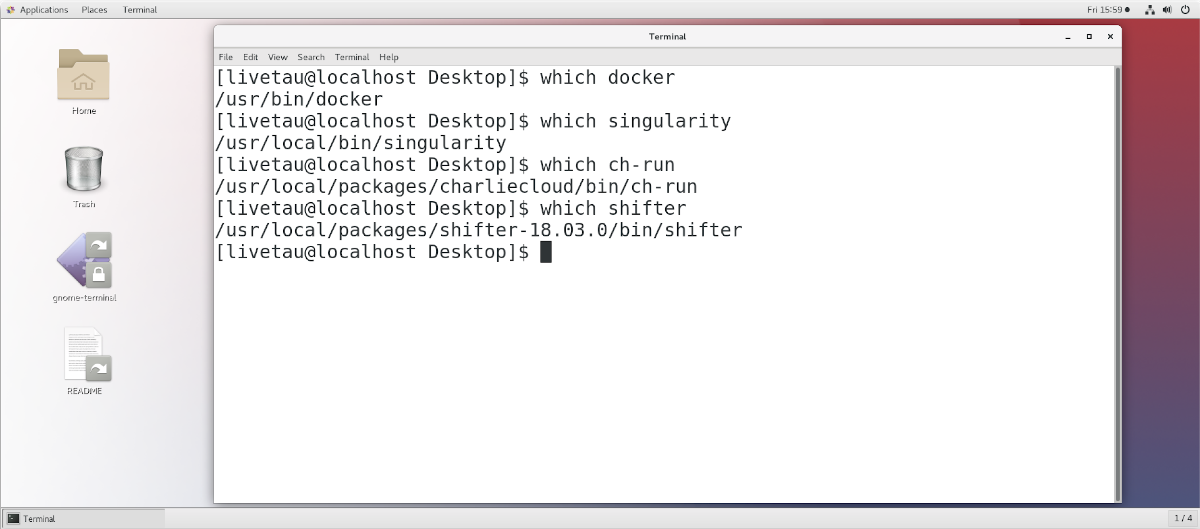
E4S VirtualBox OVA image
Contains all four container runtimes and the E4S Singularity image!
Docker
Singularity
Shifter
Charliecloud

Slide 8

E4S image on Amazon AWS
Contains all four container runtimes and the E4S Singularity image!
AWS AMI ID (Oregon, us-west-2 region):
ami-063e830287b86155c
Royalty free, public image with HPC, AI, and 4 container runtimes
Launch EC2 instance with this AMI
Login: livetau
Password: ****

Slide 9
Singularity on Theta at ALCF
% qsub -A ECP_SDK -t 30 -n 2 -q debug-cache-quad -I
% /projects/ECP_SDK/tutorial/run_job.sh
module swap PrgEnv-intel PrgEnv-gnu
module swap cray-mpich cray-mpich-abi
export SINGULARITYENV_LIBWLM_DETECT=/opt/cray/wlm_detect/1.3.2-6.0.6.0_3.8__g388ccd5.ari/lib64
aprun -n 16 -N 8 singularity exec -H $HOME -B /projects/ECP_SDK:/projects/ECP_SDK:ro -B /opt:/opt:ro -B /var/opt:/var/opt:ro /projects/ECP_SDK/containers/singularity/ecp.simg bash -c 'unset CRAYPE_VERSION; source /usr/local/packages/ecp/misc/bashrc; spack load trilinos hypre parmetis hdf5 metis openblas superlu zlib netcdf matio boost@1.66.0 scalapack suite-sparse tau ;spack unload openmpi mpich ; export LD_LIBRARY_PATH=$LIBWLM_DETECT:$CRAY_LD_LIBRARY_PATH:$CRAYPAT_LD_LIBRARY_PATH:$LD_LIBRARY_PATH ; /projects/ECP_SDK/tutorial/demo/trilinos/Zoltan/Zoltan; '

Slide 10
Singularity on Quartz at LLLNL
MVAPICH2 needs /lib. Mount it as /hostlib64 and add it to LD_LIBRARY_PATH
% salloc -N 2
% srun -n 4 -c 2 singularity exec -B /lib64:/hostlib64 -B $SLURM_SUBMIT_DIR:$SLURM_SUBMIT_DIR -B /usr/tce:/usr/tce ./ecp.simg /bin/bash -c ' . /etc/bashrc ; spack load trilinos hypre parmetis hdf5 metis openblas superlu zlib netcdf matio boost@1.66.0 scalapack suite-sparse tau; spack unload openmpi mpich; export LD_LIBRARY_PATH=/usr/tce/packages/mvapich2/mvapich2-2.2-intel-18.0.1/lib:$LD_LIBRARY_PATH:/hostlib64; ./Zoltan'

Slide 11
Replacing MPI with Shifter on Cori.nersc.gov
% shifterimg images
exascaleproject/sdk:AHM19 …
% To replace MPI with system MPI:
# salloc -N 2 -q interactive -t 00:30:00 --image=exascaleproject/sdk:AHM19 -C haswell -L SCRATCH
# ~sameer/run_shifter.sh
# cat ~/run_shifter.sh
srun –n 32 shifter -- /bin/bash -c 'unset CRAYPE_VERSION; . /etc/bashrc ; spack load trilinos hypre parmetis hdf5 metis openblas superlu zlib netcdf matio boost@1.66.0 scalapack suite-sparse tau; spack unload openmpi mpich; ./Zoltan'

Slide 12
Future work, issues…
Increasing the number of ST packages in E4S
Porting to IBM and ARM platforms
Support for GPUs and visualization tools
Addition of CI testing
Facility deployment
Scalable startup with full-featured “Supercontainers”
Improving the launch of MPI applications

Slide 13

Acknowledgment
“This research was supported by the Exascale Computing Project (17-SC-20-SC), a collaborative effort of two U.S. Department of Energy organizations (Office of Science and the National Nuclear Security Administration) responsible for the planning and preparation of a capable exascale ecosystem, including software, applications, hardware, advanced system engineering, and early testbed platforms, in support of the nation’s exascale computing imperative.”

